Slide 1

Build‘A Pizza
Michael Plasmeier
Chris Ryder

Slide 2
Gourmet Pizza
Like Peace A Pizza
  There are none in Havertown
  They are not focused on delivery
  Exotic topings
But with Mass Market Efficiency of Dominoes
  Internet
  Delivery
And the build your own craze

Slide 3
Choices
Size
  Small
  Medium
  Large
  X-Large
Dough
  Regular
  Whole Wheat
Crust
  Crispy
  Stuffed Crust
  Deep Dish
Cheese
  Regular
  Cheddar
  Goat Cheese
Sauce
  Regular
  Spicy
Toppings
  Next Slide

Slide 4
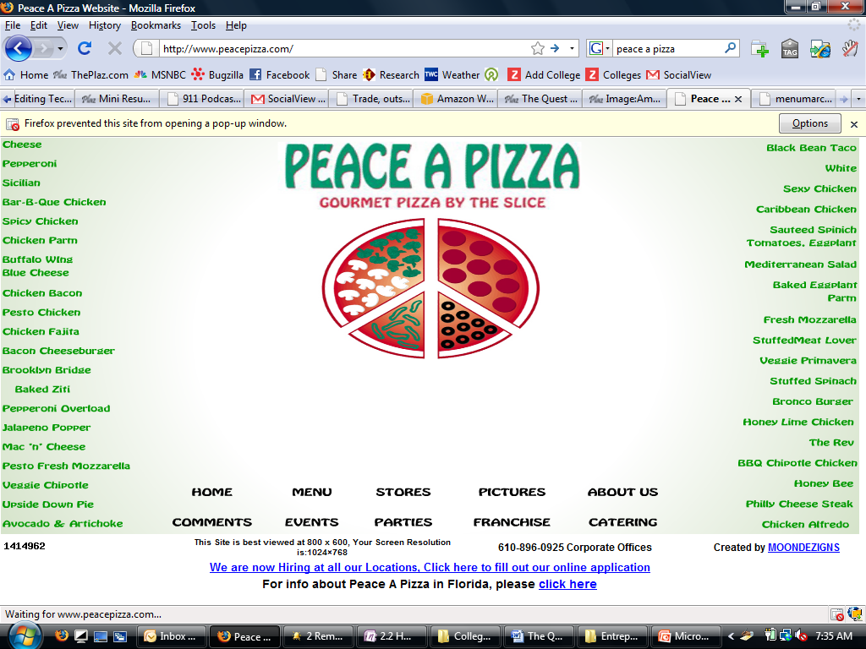
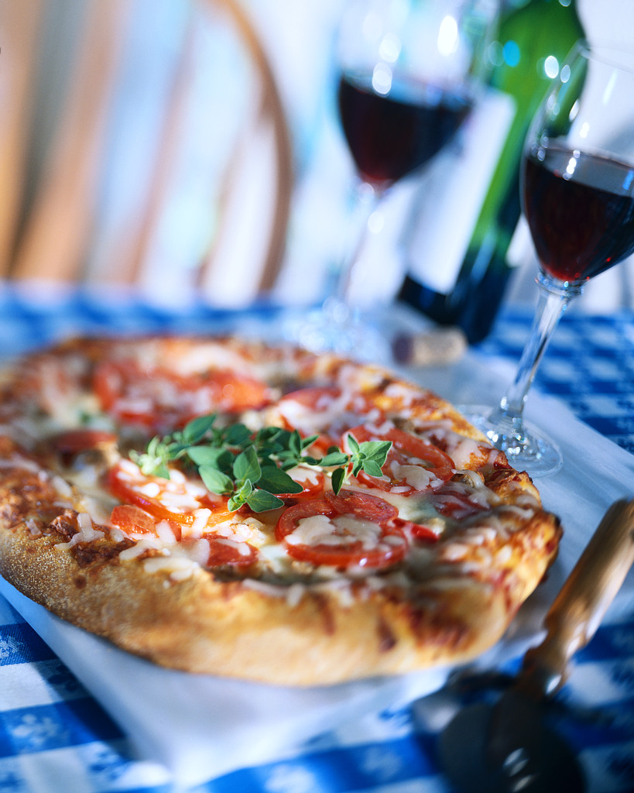
Toppings

Slide 5
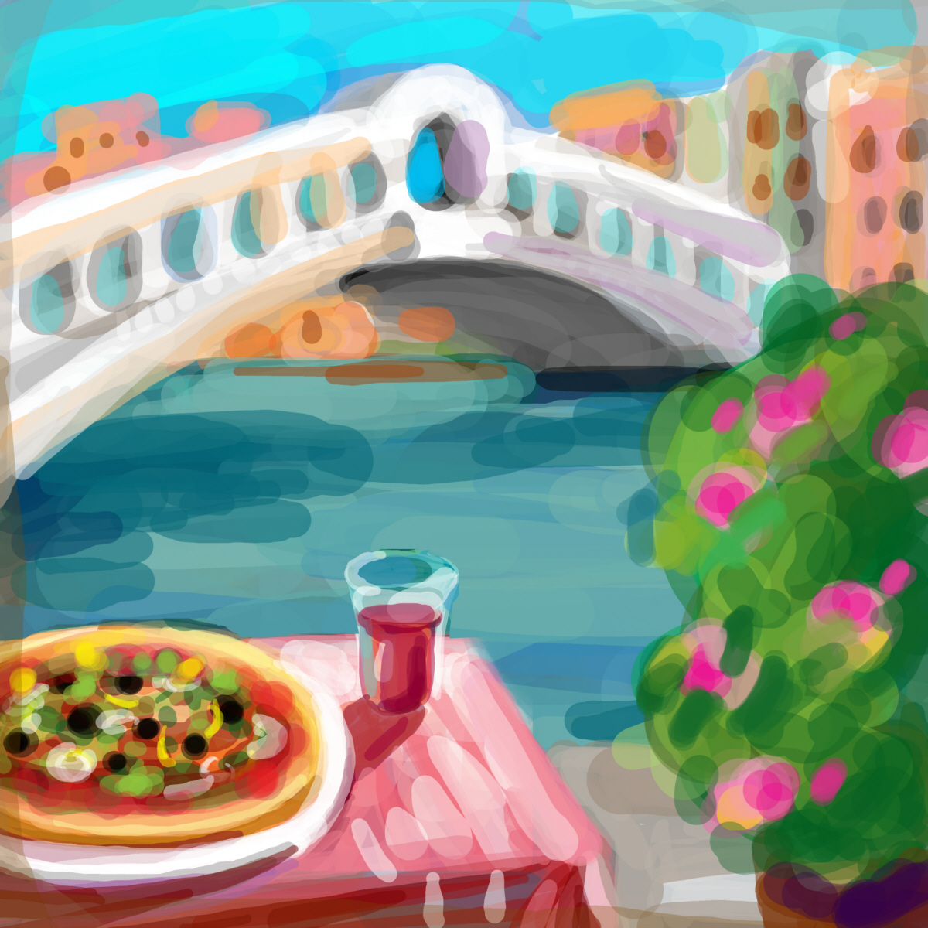
Audience
Upmarket
Technical-savvy will use the online ordering
Prices
Up market prices
Up market quality and service

Slide 6
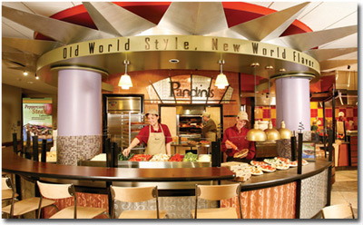
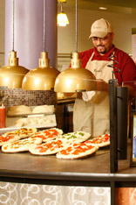
Store

Slide 7
Internet
Driven by the internet
Customize pie/salads online with our rich experience

Slide 8
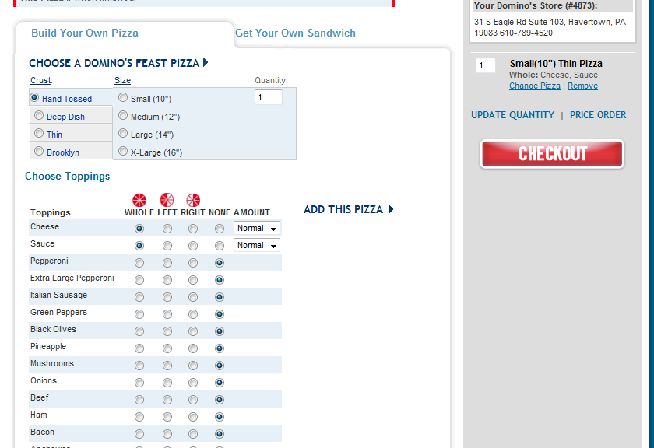
Ordering

Slide 9
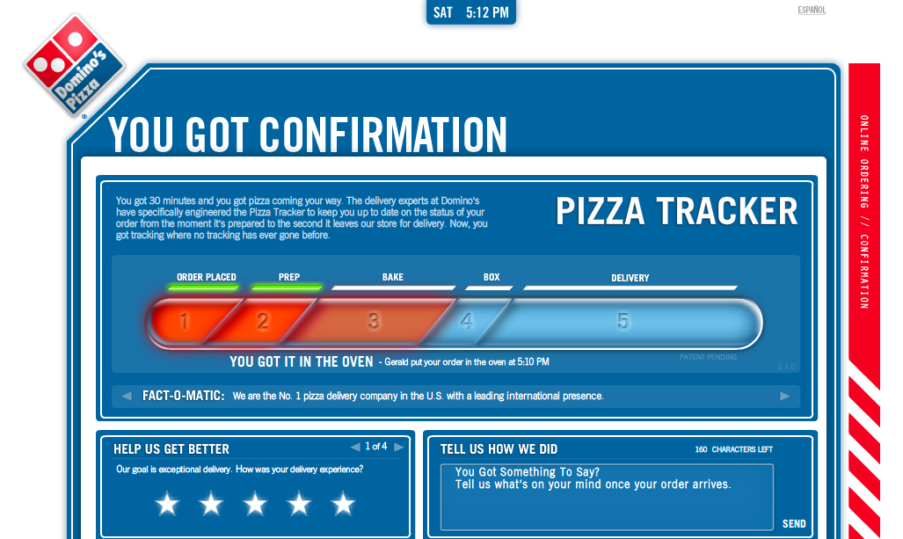
Tracking

Slide 10

Advertising
Press coverage with news release
Online local advertising
As you order you can invite friends from your social network to come over for pizza

