Slide 1
CrossPassword
theplaz, jwang7, mflores
6.858 Project
12/12/2012

Slide 2
Someone can see you type it in
When you type in a password
Could you somehow prove you know the password without directly entering it?

Slide 3

Let’s say your password is
tennis ball
What color is it?
green
What shape is it?
round
Could we enter those instead?

Slide 4
Introducing
CrossPassword

Slide 5
Demo
Password: abc

Slide 6
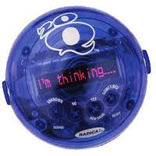
Let’s say your password is
tennis ball
What color is it?
green
What shape is it?
round
Sound Familiar?
With enough questions answered, you can guess the password.

Slide 7
Let’s say your password is
tennis ball
What color is it?
green
blue
red
black
yellow
orange
What shape is it?
round
rectangular
triangular
none
Limited answers can lead to brute force attacks.

Slide 8
CrossPassword: How to fix it?
Increase bits of entropy in the response
Rate limit password attempts
Increase usability/decrease time to log in
Stripe the direction currently looking at
Many tradeoffs!

