Slide 1
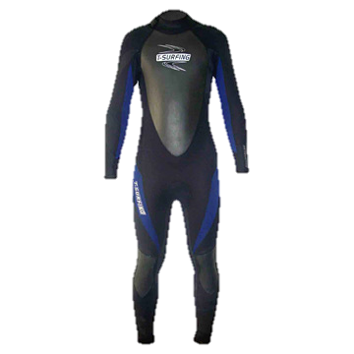
Divers’ Delight
The Nanotube Wetsuit
Michael Plasmeier
CEO
Notes:
Jack Stow
Have quick presentation

Slide 2
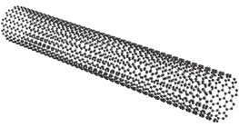
Product
Individual Nanotube Filaments
5°C warmer than competition
Nothing else like it on the market
No need for electricity!
MSRP $400
Exclusively through dive shops
Notes:
Own 5 patents

Slide 3
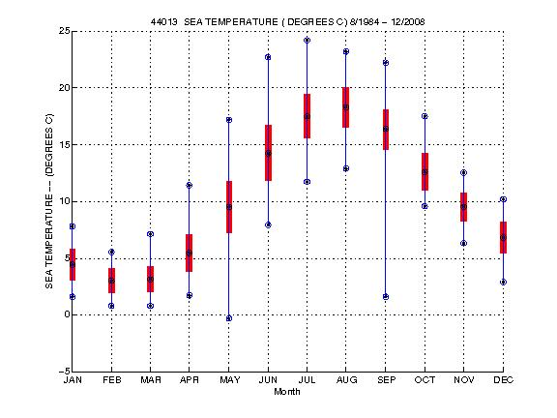
Extend Northern Dive Season
3 months to 5 months
MA waters from NOAA
http://www.ndbc.noaa.gov/view_climplot.php?station=44013&meas=st
Notes:
Loan to Put on rental to try it out
It’s sept now
160% increase

Slide 4
Funding
U.S. Navy Seals
Research contract
We retain IP rights (5 patents)
Hitz Ventures
Isreal
Menlo Partners
Menlo Park, CA
Central Custom
Contract Manufacturers

Slide 5
Questions?
Notes:
Sell 2 of each side
Start by asing for 3 of each size for all 25 stores
Throw in free test ones if hesitant

Slide 6
Contact
Michael Plasmeier
CEO
(555) 555 – 5555
77 Massachusetts Ave
Cambridge, MA

