Slide 1
Good & Bad Design
Michael Plasmeier

Slide 2
Good Design

Slide 3
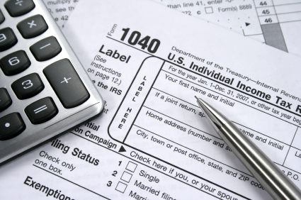
1040

Slide 4
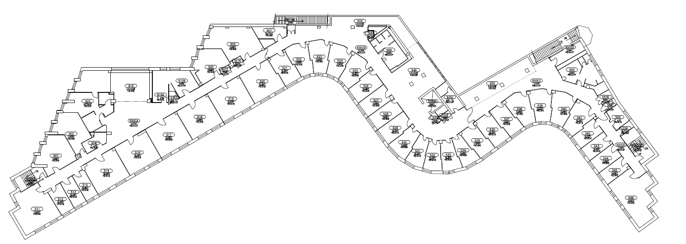
Baker House

Slide 5
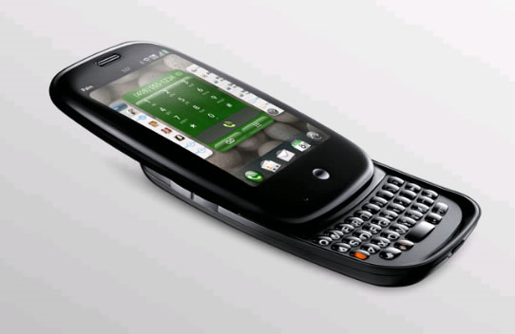
Palm Pre

Slide 6
Bad Design

Slide 7
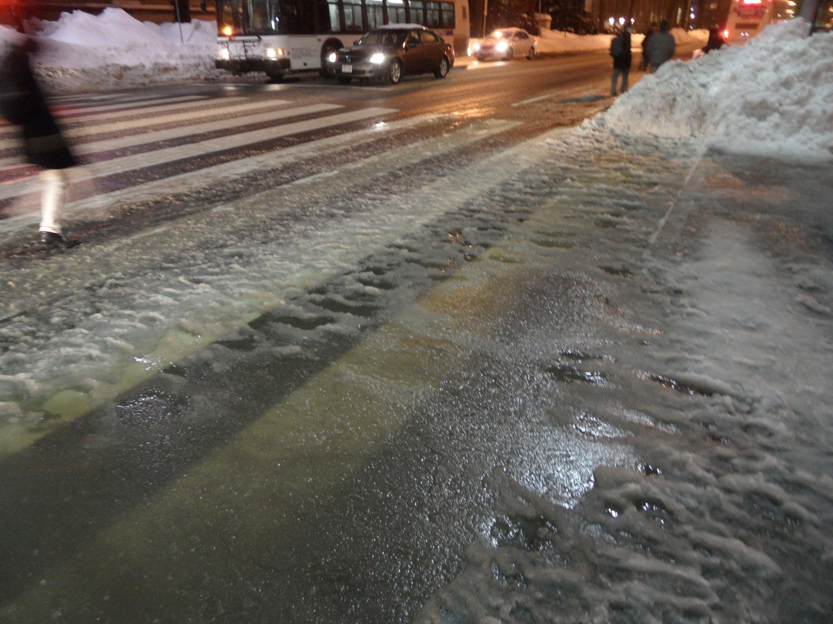
77 Mass Ave Crossing

Slide 8
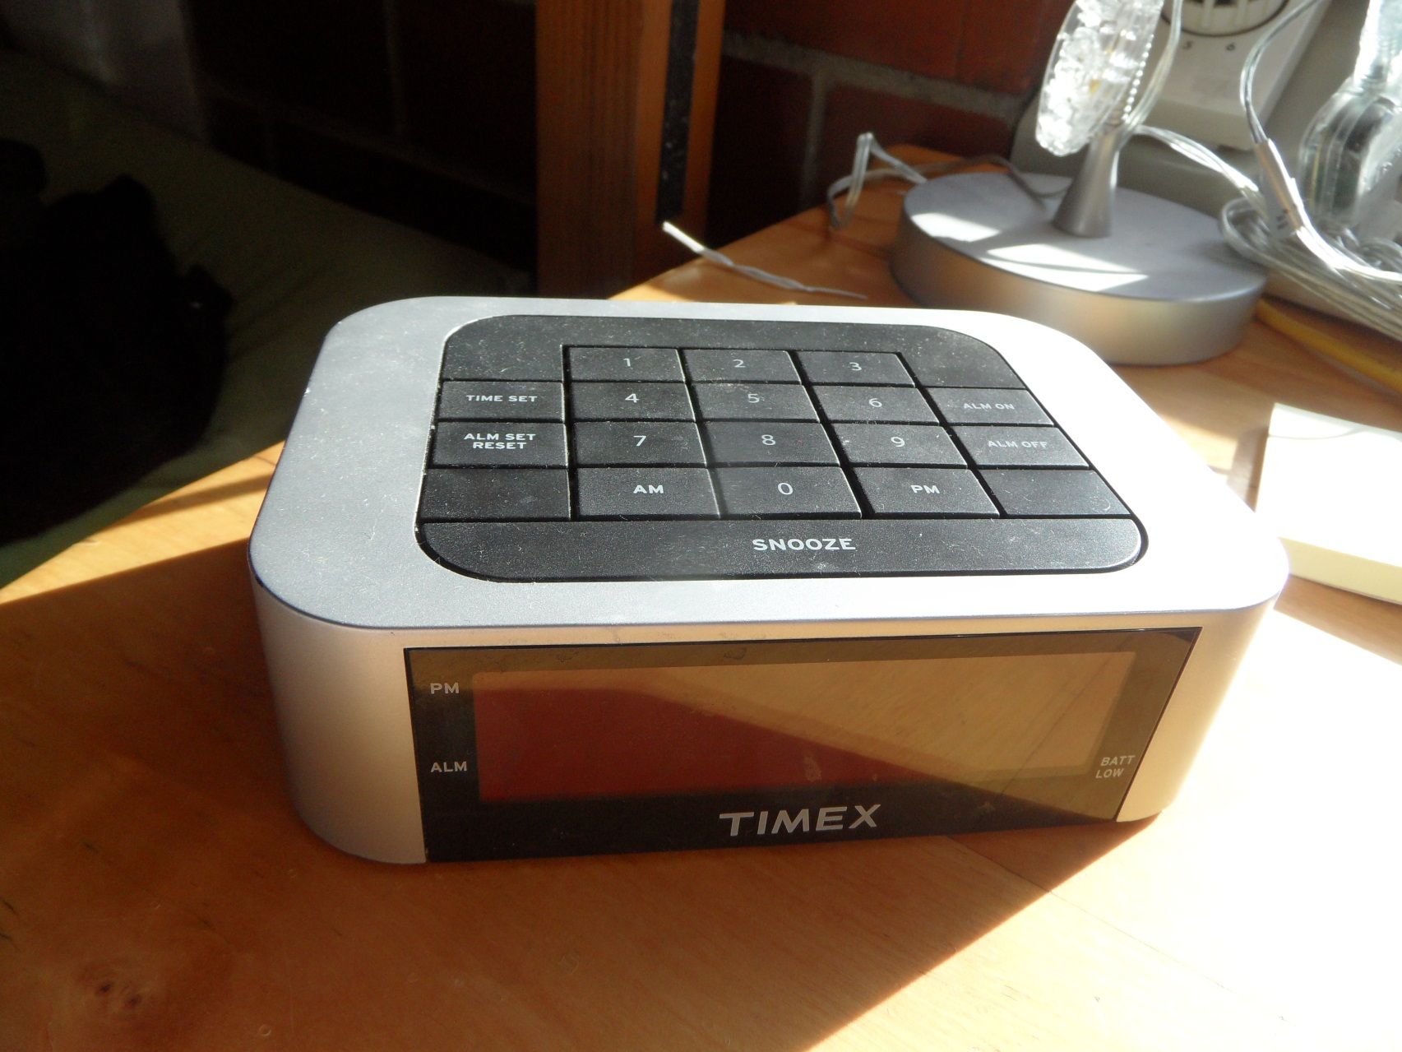
My Alarm Clock

Slide 9
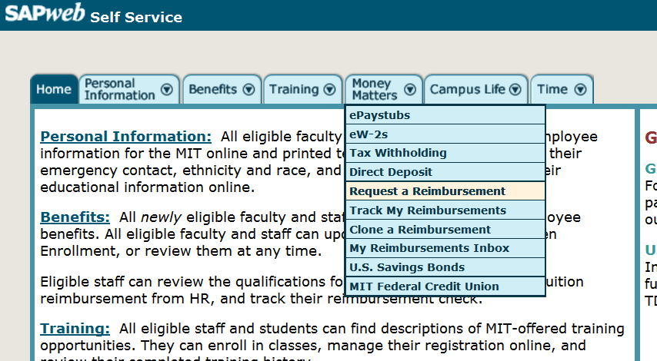
SAP Reimbursements

