Slide 1
Videre
Online Grade Book Analytics and Trend Monitoring

Slide 2
People
Michael – Programmer
Jason – Algorithm R&D, Programmer
Jay – Warnings, Alerts, and Newsfeed, Programmer
Andrew – Graphing Libraries, Programmer
Talisha – UI Design and CSS Implementation

Slide 3
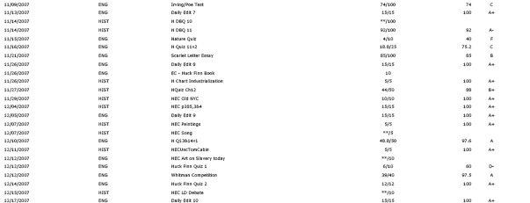
Problems
Online Grade Books are Boring Data Tables

Slide 4
Problems
Parents wait to find about bad grades
Grades over time cannot be seen at a glance
Students cannot compare their grades to their average and the class average
Grade trends between multiple classes cannot be identified
Students do not know when grades are added/updated
Students are not able to focus attention on certain classes

Slide 5
Videre
Create a user-friendly trend monitoring system for grades.
Simple Warnings
Graphing
Class Average Comparison
Algorithm for Trend
Newsfeed
What If
Tips

Slide 6
Technical Challenges
PHP and MySQL
Database abstraction
Algorithm Design and Implementation
Graphing Library
Sending Text Messaging
UI Interface
Notes:
Talk about person who is falling behind in 1 class since grandma died – but other teachers don’t know

